Slide 1
Movie Application Using TheMovieDB.

Slide 2
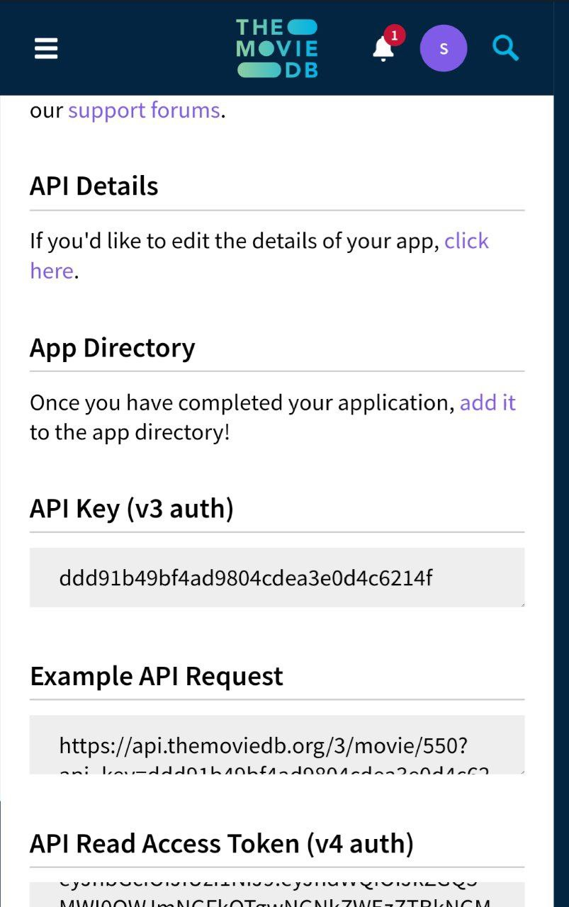
TheMovieDb API:-
The TMDb or TheMovieDb API is a resource for any developers that want to integrate movie, TV show and cast data along with posters or movie fan art. themoviedb.org is a free and community edited database.

Slide 3
Technology Used:-
JavaScript.
HTML.
CSS.
TMDB API key.

Slide 4
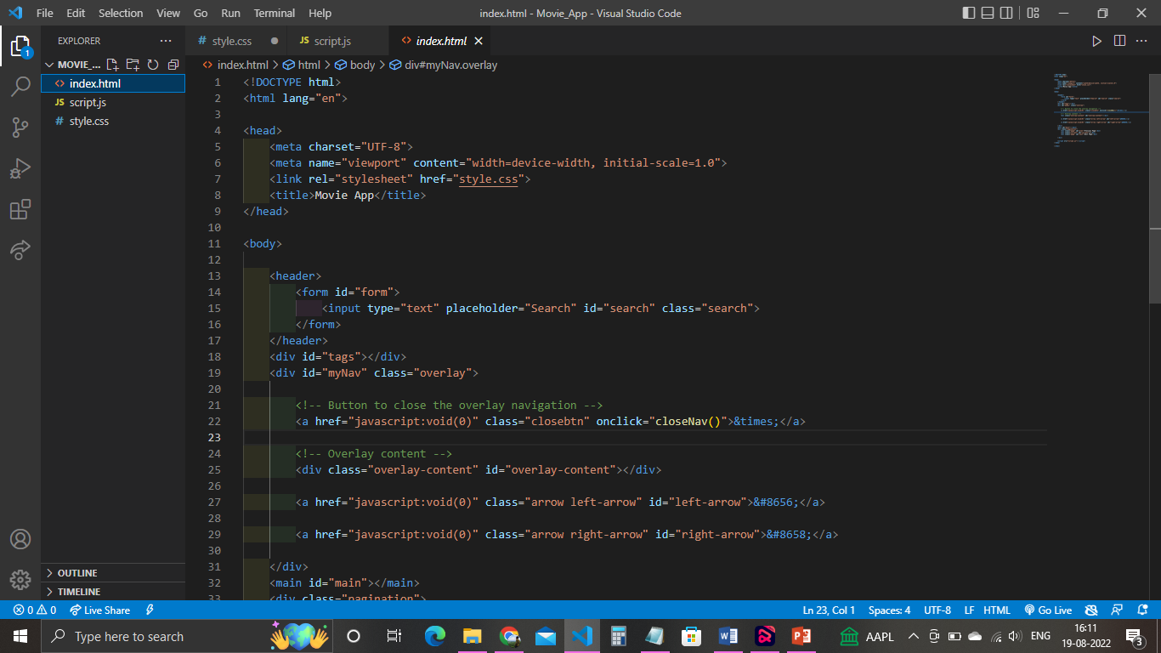
Making The Index Page:-

Slide 5
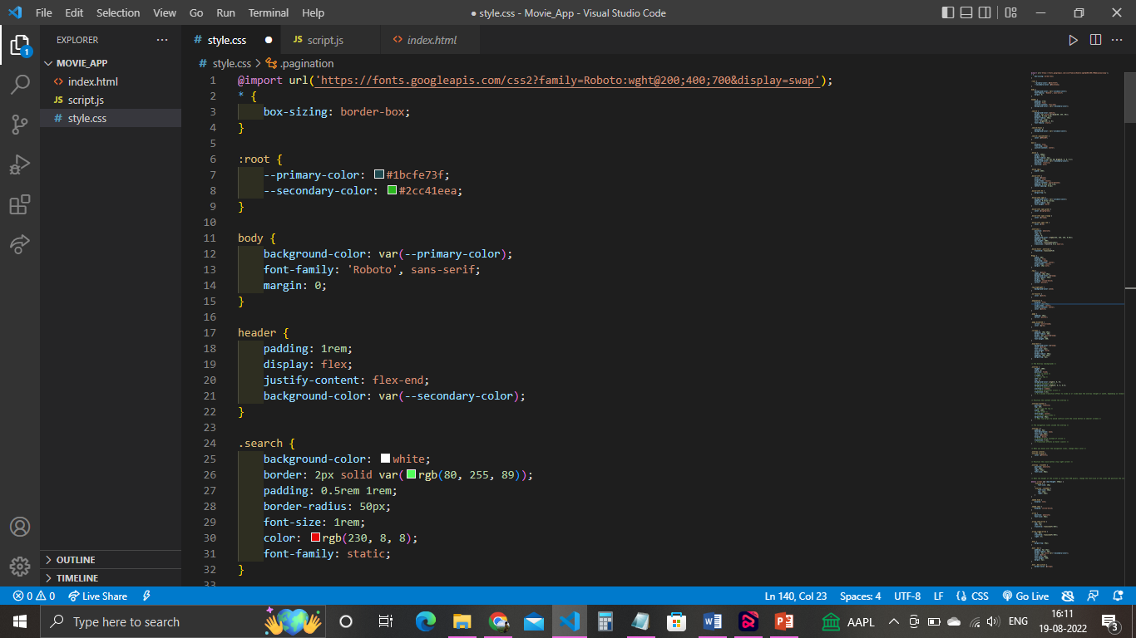
Build The Design by CSS:-

Slide 6
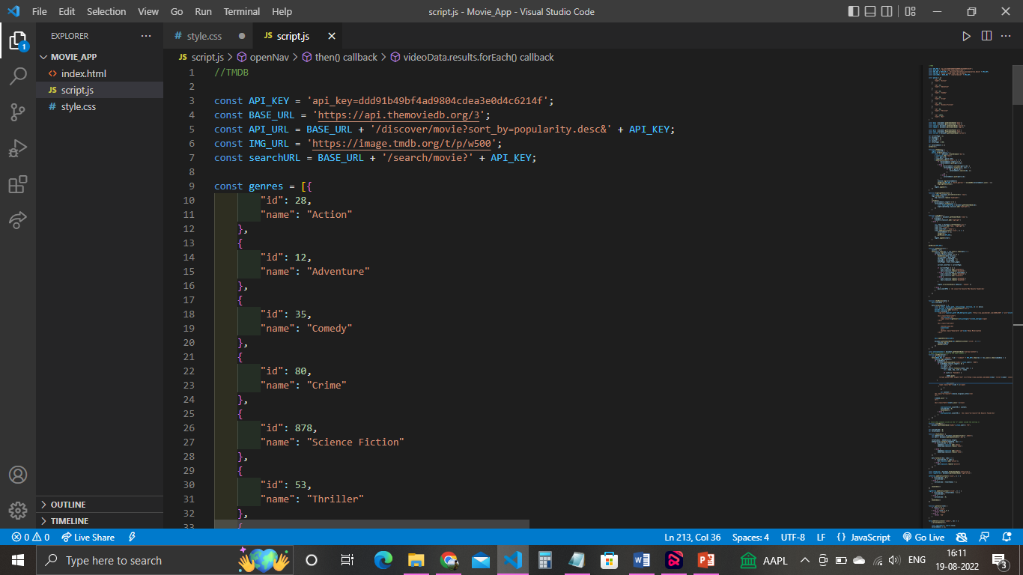
Building The Api Connection By JavaScript.

Slide 7
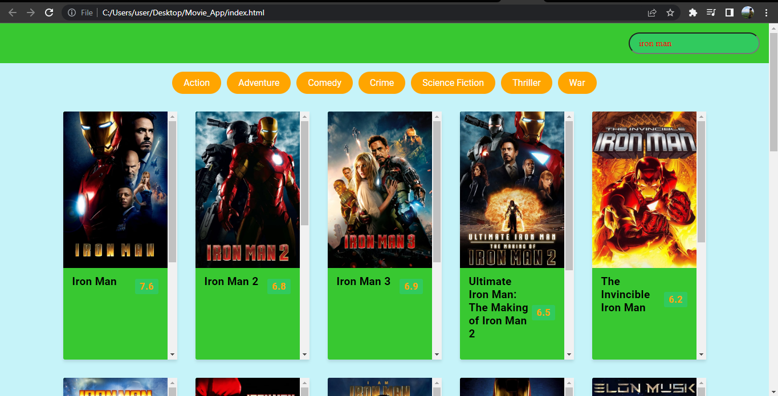
Some Screenshot of the website:-

Slide 8
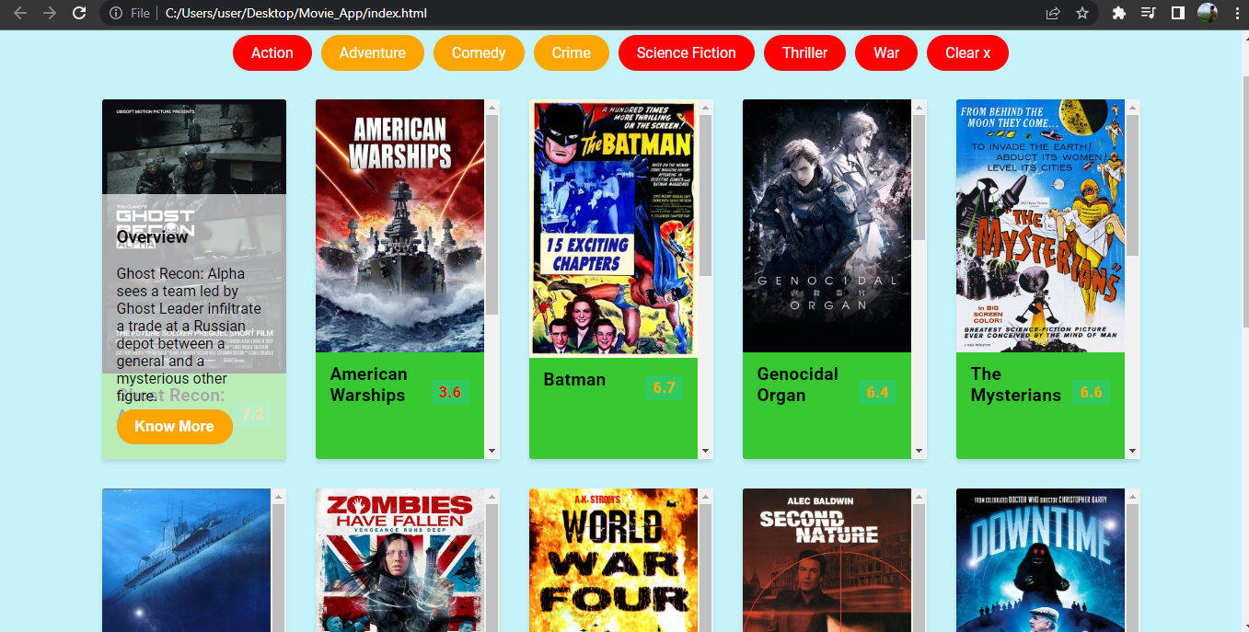
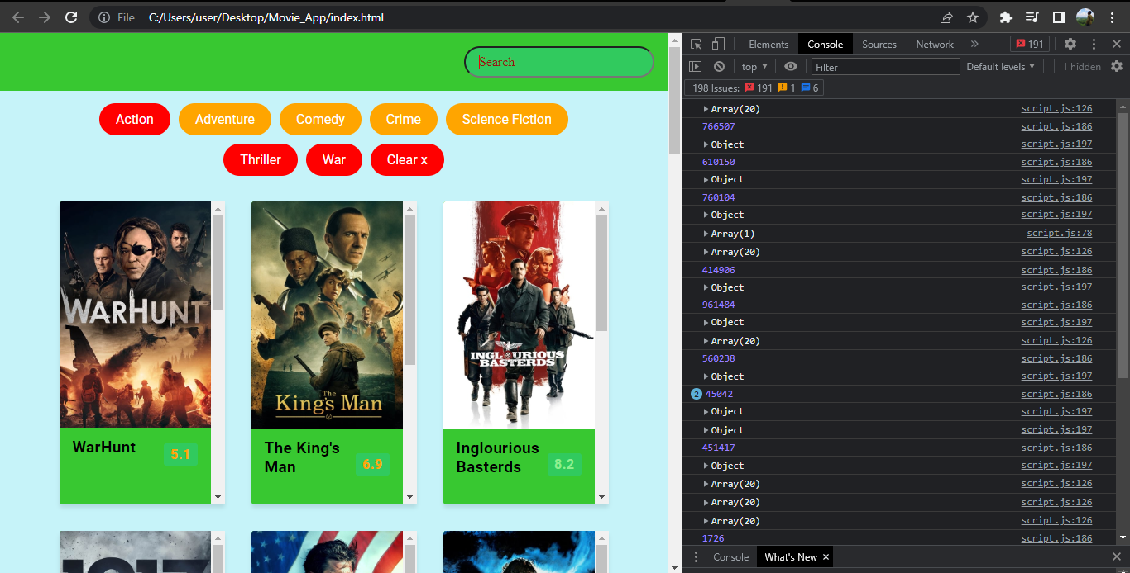
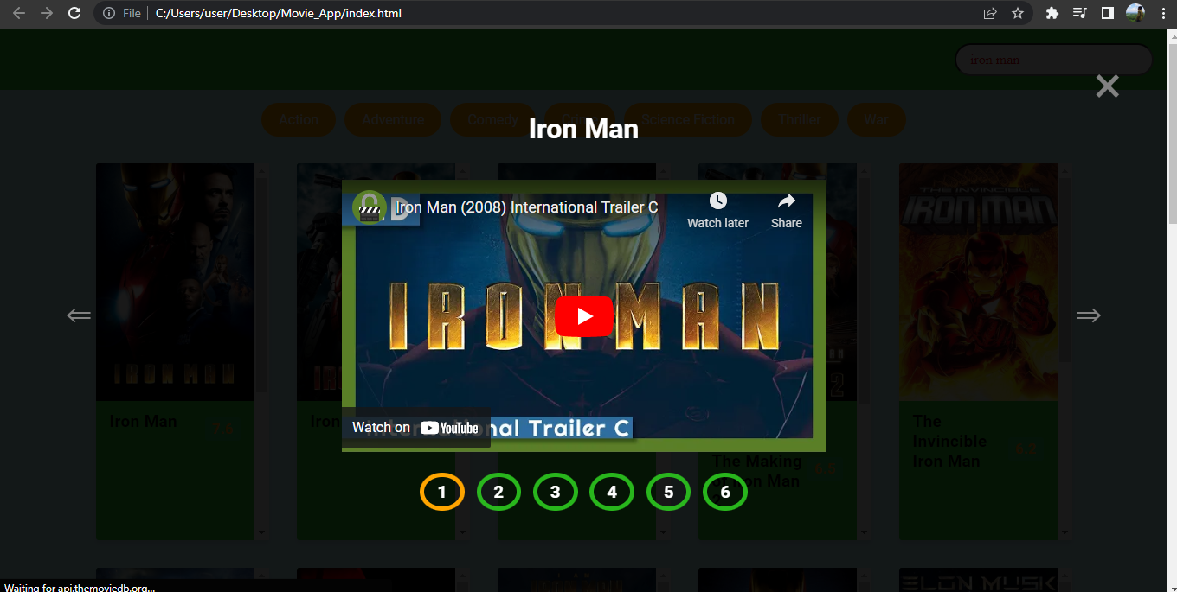

Slide 9
Thank You

